Slide 1
Analysis on play-store using python dashboard
- Prem Mandal
Data Scientist

Slide 2
Problem Statement
What are the total sales by segment in each /all years?
What are the total sales ,quantity ,discount and profit in each /all years?
What are the profit sales in different regions in each /all years?
What are the total quantity in different /all categories in each /all years?
What is the total sales in different /all categories in each /all years
What is the total profit in different /all categories in each /all years?
What is the sum of ship mode in terms of sales in each /all years?
- Prem Mandal
Data Scientist

Slide 3
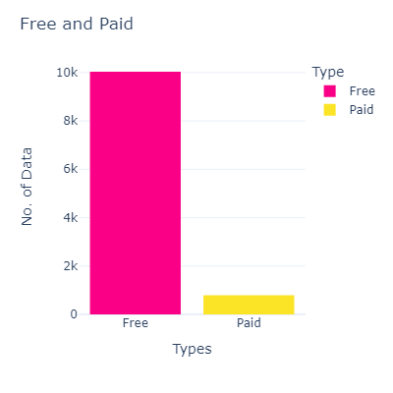
Problem statement 1 What are the total app Distribution
Insights:
Free apps are more than the Paid apps
- Prem Mandal
Data Scientist

Slide 4
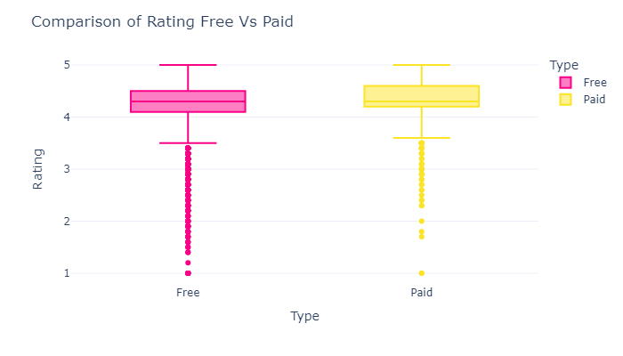
Problem statement 1 Comprision rating between free vs paid app
Insights:
The average rating of Paid is higher than the free application .
- Prem Mandal
Data Scientist

Slide 5
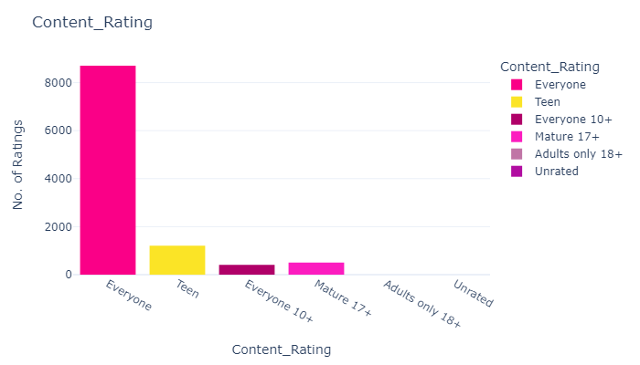
Problem statement 1 What are the Most rated conten rating .
Insights:
As we can see the most of the apps are in the Everyone Category ,then followed by the teen and everyone 10+.
- Prem Mandal
Data Scientist

Slide 6
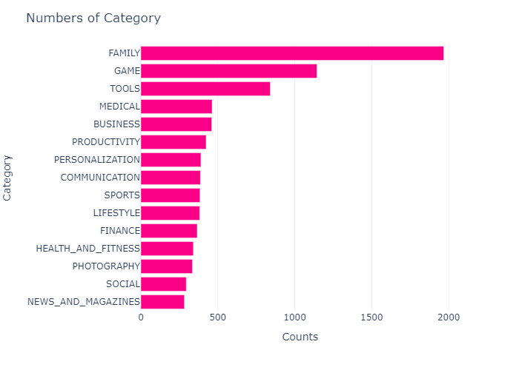
Problem statement 1 From what category most of the applications are in?
Insights:
As we can see the most application are in the family category then followed by the games and Tools.
- Prem Mandal
Data Scientist

Slide 7
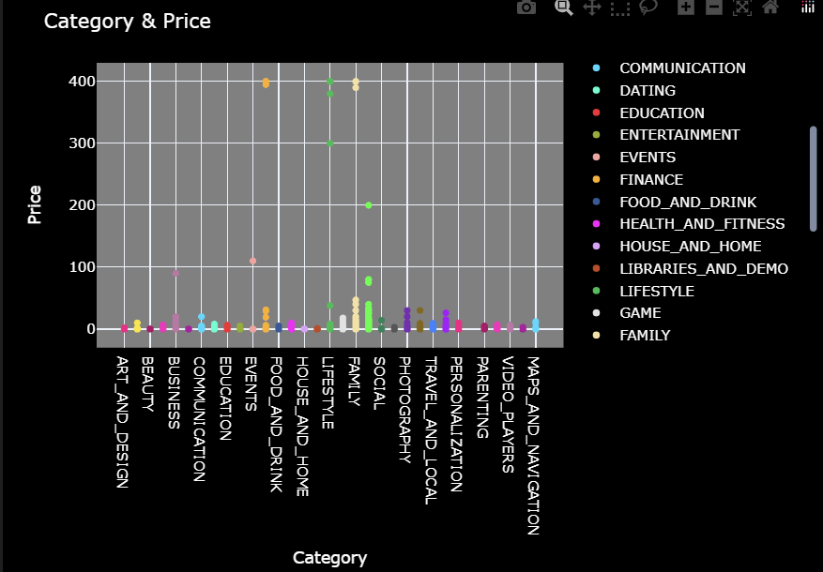
Problem statement 1 What are the relationship between Category & Price
Insights:
Notice the most applications are Finance ,Lifestyle and followed by Family..
- Prem Mandal
Data Scientist

Slide 8
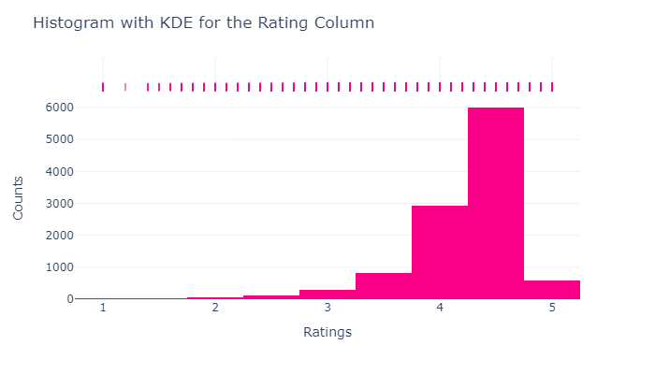
Problem statement 1 What are the rating distribution
Insights:
As we can see the most values are distributed around 4.3 .
- Prem Mandal
Data Scientist

Slide 9
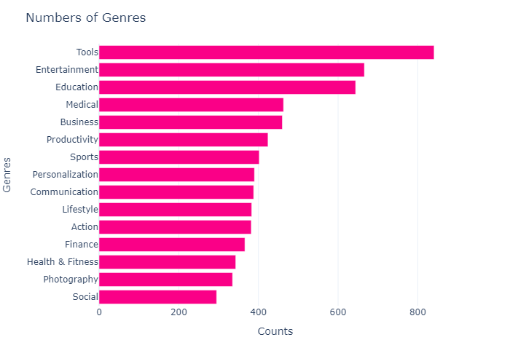
Problem statement 1 what are the top 15 genres of play-store
Insights:
Notice that the most genre from tools ,Entertainment and followed by other .
- Prem Mandal
Data Scientist

Slide 10
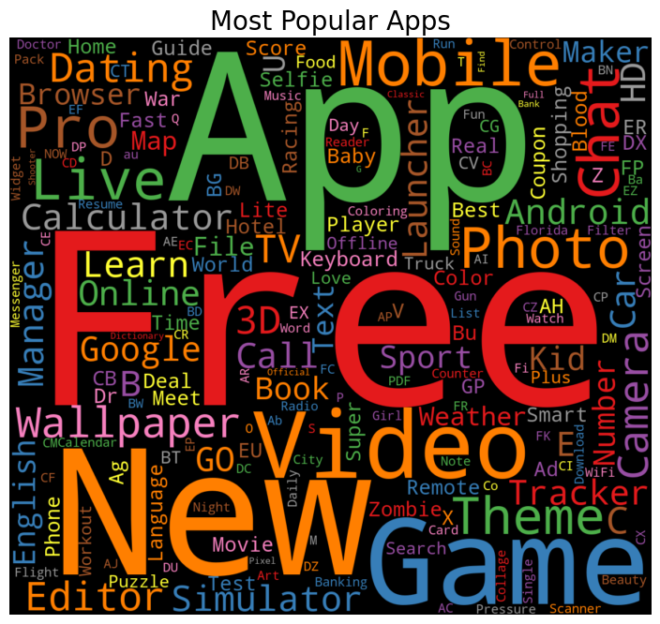
Problem statement 1 what are the top 15 genres of play-store
- Prem Mandal
Data Scientist

Slide 11
conclusion
Superstore got the highest sales from the consumers segment.
Western region made the highest sales profit and central region made the lowest.
Technology category made the highest sales and profit .
Standard class ship mode was the most used by segment .
There was steady progress in both profit and quantity of the superstore 2014 -2017
- Prem Mandal
Data Scientist

